Slide 1
ORBITAL MECHANICS AND LAUNCHERS
ORBITAL MECHANICS !!
Notes:
1
1

Slide 2
ORBITAL MECHANICS AND LAUNCHERS:
Contents:
1. Orbital Mechanics
2. Look Angle determination
3. Orbital Perturbations
4. Orbit determination
5. Launches and Launch vehicles
6.Orbital effects in communication systems performance
Notes:
3
3

Slide 3
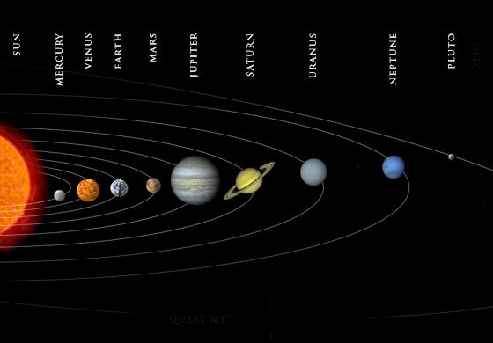
ORBITAL MECHANICS !!
Notes:
1
1

Slide 4
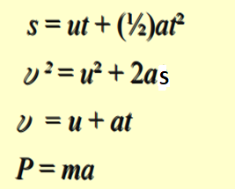
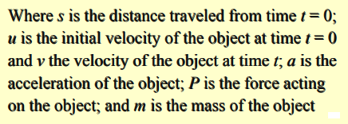
1. ORBITAL MECHANICS Developing the Equations of the Orbit
Newton’s laws of motion can be encapsulated into four equations:
Of these four equations, it is the last one that helps us understand motion of a satellite in a stable orbit (neglecting any drag or other perturbing forces).
Also the above last equation states that the force acting on a body is equal to mass of the body multiplied by the resulting acceleration of the body.
P = m x a

Slide 5
The resulting acceleration is the ratio of the force acting on the body to the mass of the body. (a = P / m )
Thus for a given force, the lighter the mass of the body, the higher the acceleration will be.
When in a stable orbit, there are two main forces acting on a satellite:
1) a centrifugal force 2) a centripetal force
A centrifugal force due to the kinetic energy of the satellite, which attempts to fling the satellite into a higher orbit.
A centripetal force due to gravitational attraction of the planet about which the satellite is orbiting, which attempts to pull the satellite down toward the planet.
Gravitational force is inversely proportional to the square of the distance b/w the centers of gravity of the satellite and the planet the satellite is orbiting, in this case the earth.

Slide 6
The gravitational force inward (F_{IN}, the centripetal force) is directed toward the centre of gravity of the earth.
The kinetic energy of the satellite (F_{OUT}, the centrifugal force) is directed diametrically opposite to the gravitational force.
Kinetic energy is proportional to the square of the velocity of the satellite.
When these inward and outward forces are balanced, the satellite moves around the earth in a “free fall” trajectory: the satellite orbit.

Slide 7
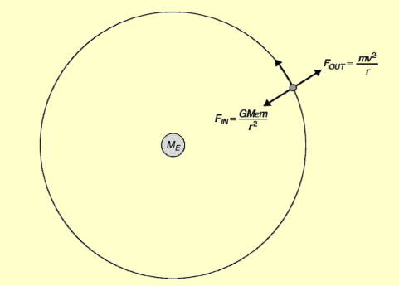
If these two forces are equal, the satellite will remain in a stable orbit.
It will continually fall toward the planet’s surface as it moves forward in its orbit but, by virtue of its orbital velocity, it will have moved forward just far enough to compensate for the ‘fall’ toward the planet and so it will remain at the same orbital height. This is why an object in a stable orbit is sometimes described as being in ‘free fall’.
Figure : Forces acting on a satellite in a stable orbit around the earth.
The above figure shows the two opposing forces on a satellite in a stable orbit.

Slide 8
F = m x a Newton(N)
Newton is the force required to accelerate a mass of 1 kg with an acceleration of 1 m / s2.
In Imperial units, One Newton = 0.2248 ft-lb.
The standard acceleration due to gravity at the earth’s surface is 9.80665 × 10 ⁻ ³ km/s², which is often quoted , as 981 cm/s², 9.8 m/s² .
This value(a) decreases with height above the earth’s surface.
The acceleration, a, due to gravity at a distance r form the center of the earth is a = µ / r² km/s²
where the constant µ is the product of the universal gravitational constant G and the mass of the earth M_{E}. (µ = GM_{E} )
The product GM_{E} is called Kepler’s constant(µ)and has the value 3.986004418 × 10 5 km³/s². , ME = 5.972X 10 24 kg.
The universal gravitational constant is G = 6.672 ×10 -11 Nm²/kg² or 6.672 ×10-²º km³ /kg s² in the older units.

Slide 9
Since force = mass × acceleration,
The centripetal force acting on the satellite, F_{IN}, is given by
F_{IN} = m × (μ / r²) = m × (GM_{E} / r²) ……(2.5)
In a similar fashion, the centrifugal acceleration is given by
a = v²/r
Which will give the centrifugal force, F_{OUT}, as
F_{OUT} = m × (v²/r).

Slide 10
If the forces on the satellite are balanced, F_{IN} = F_{OUT} and, using Eqs
m × μ/r² = m ×v²/r
Hence the velocity v of a satellite in a circular orbit is given by
v = (μ/r) ½
If the orbit is circular, the distance traveled by a satellite in one orbit around a planet is 2πr.
where r is the radius of the orbit from the satellite to the center of the planet.
Since distance divided by velocity equals time to travel that distance,(t= s/v)
The period of the satellite’s orbit, T, will be
T = (2πr) / υ = (2πr) / [ (μ/r)½ ] = (2πr^{3/2}) / (μ½)
Giving
T = (2πr^{3/2}) / (μ½) ------------------- (2.6)

Slide 11
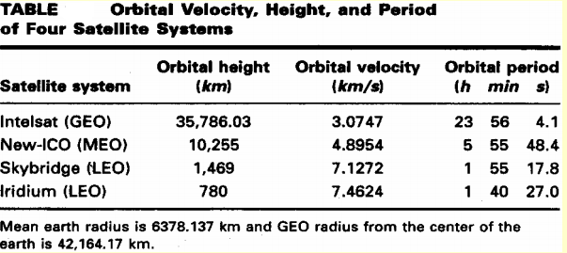
Table gives the velocity v, and orbital period T, for four satellite systems that occupy typical LEO,MEO, and GEO orbits around the earth.
In each case, the orbit are circular and the average radius of the earth is taken as 6378.137 km.

Slide 12
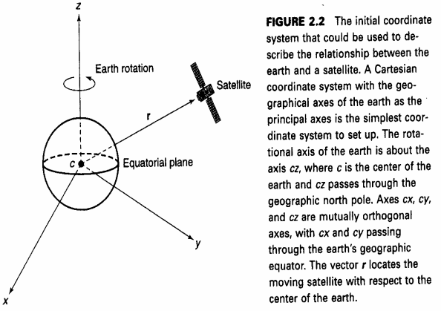
‘A number of coordinate systems and reference planes can be used to describe the orbit of a satellite around a planet. Fig.2.2 illustrates one of these using a Cartesian coordinate system with the earth at the center and the reference planes coinciding with the equator and the polar axis. This is referred to as a geocentric coordinate system.

Slide 13
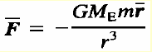
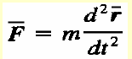
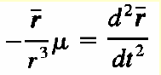
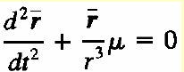
From the above Fig.2.2, and with the satellite mass m located at a vector distance r from the center of the earth. F in= m × (μ / r²)
The gravitational force F on the satellite is given by [From (2.5)]
Where M_{E} is the mass of the earth and G = 6.672 × 10-11 Nm²/kg² .
But force = mass × acceleration and Eq. above can be written as
From the above Eq. , we have
Which yields , ------------------ (2.10)
This is a second-order linear differential equation and its solution will involve six undetermined constants called the orbital elements.

Slide 14
The orbit described by these orbital elements can be shown to lie in a plane and to have a constant angular momentum.
The solution to above second order equation is difficult since the second derivative of r involves the second derivative of the unit vector r.
To remove this dependence, a different set of coordinates can be chosen to describe the location of the satellite such that the unit vectors in three axes are constant.

Slide 15
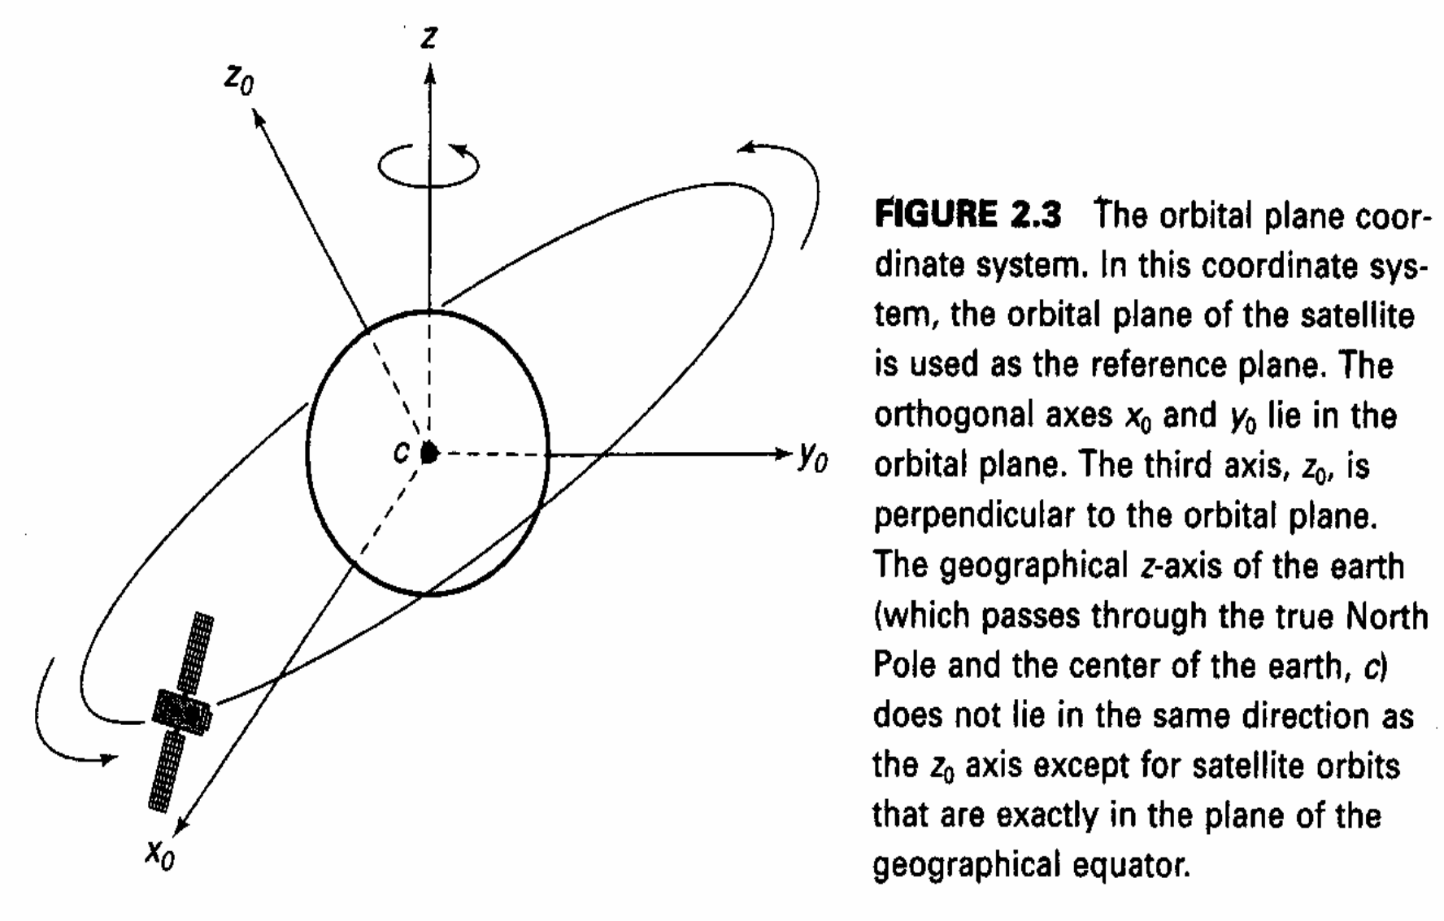
The coordinate system uses the plane of the satellite’s orbit as the reference plane. This is shown in Fig. 2.3.

Slide 16
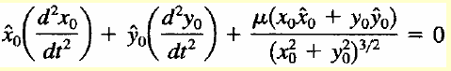
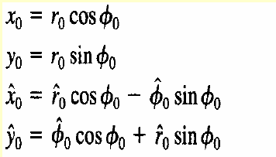
Expressing Eq.(2.10). above in terms of the new coordinate axes x0, y0 and z0 gives
(2.11)
The above equation is easier to solve if it is expressed in a polar coordinate system rather than a Cartesian coordinate system.
The polar coordinate system shown in Fig. 2.4.
With the polar coordinate system and using the transformations

Slide 17
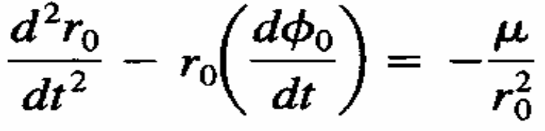
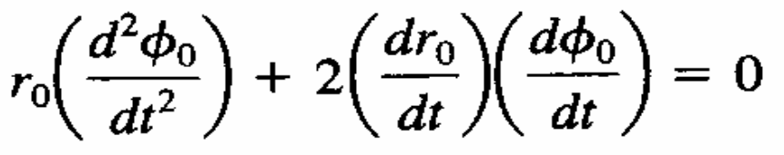
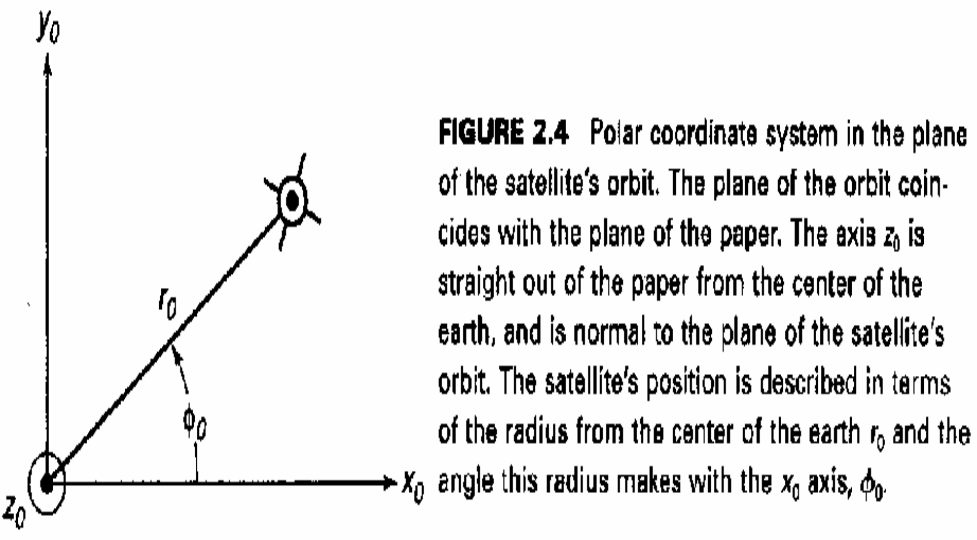
and equating the vector components of r₀ and ø₀ in turn in Eq. (2.11) yields
(2.13)
(2.14)
and

Slide 18
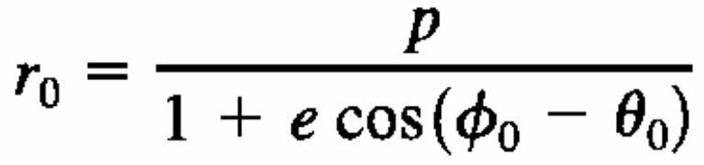
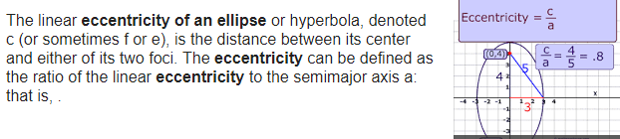
Using standard mathematical procedures, we can develop an equation for the radius of the satellite's orbit, r₀, namely
(2.15)
Where θ₀ is a constant and e is the eccentricity of an ellipse whose semilatus rectum p is given by
P = (h ²)/µ
(2.16)
and h is the magnitude of the orbital angular momentum of the satellite.
That the equation of the orbit is an ellipse is Kepler’s first law of planetary motion.
The eccentricity of an ellipse is a measure of how nearly circular the ellipse. Eccentricity is found by the following formula eccentricity = c/a where c is the distance from the center to the focus of the ellipse, a is the distance from the center to a vertex

Slide 19
Kepler’s Three Laws of Planetary Motion
Johannes Kepler (1571-1630) was a German astronomer and scientist who developed his three laws planetary motion by careful observations of the behavior of the planets in the solar system over many years, with help from some detailed planetary observations by the Hungarian astronomer Tycho Brahe.

Slide 20
Kepler’s three laws
The orbit of any smaller body (Satellite) about a larger body (Earth) is always an ellipse, with the center of mass of the larger body as one of the two foci.
The orbit of the smaller body sweeps out equal areas in equal time (see Figure 2.5).
The square of the period of revolution of the smaller body about the larger body equals a constant multiplied by the third power of the semimajor axis of the orbital ellipse. That is, T² = (4π²/ µ) a³
where T is the orbital period, µ is Kepler’s constant.
a is the semimajor axis of the orbital ellipse, and
If the orbit is circular, then a becomes distance r, defined as before, and we have Eq. (2.6).
Describing the orbit of a satellite enables us to develop Kepler’s second two laws.

Slide 21
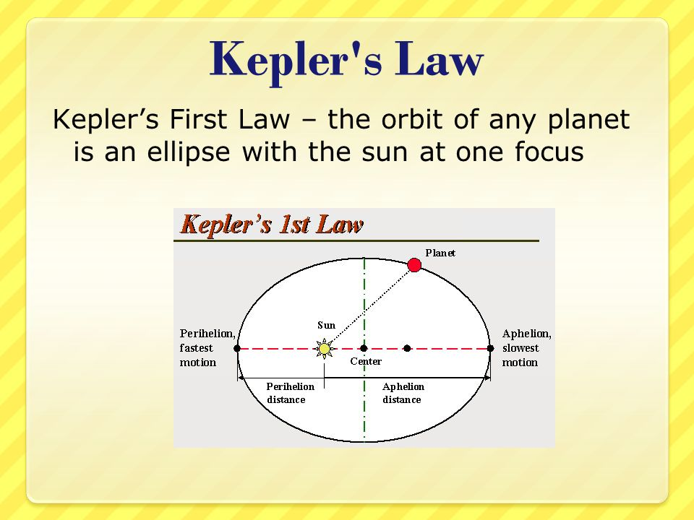
Kepler’s first law states that the path followed by a satellite around its primary (the earth) will be an ellipse.

Slide 22
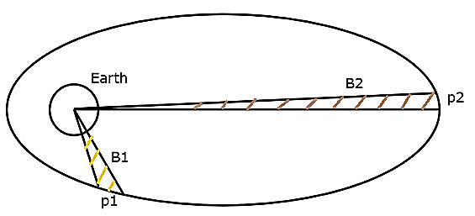
Kepler’s Second Law
Kepler’s second law states that for equal intervals of time, the area covered by the satellite will be same with respect to center of mass of the earth.

Slide 23
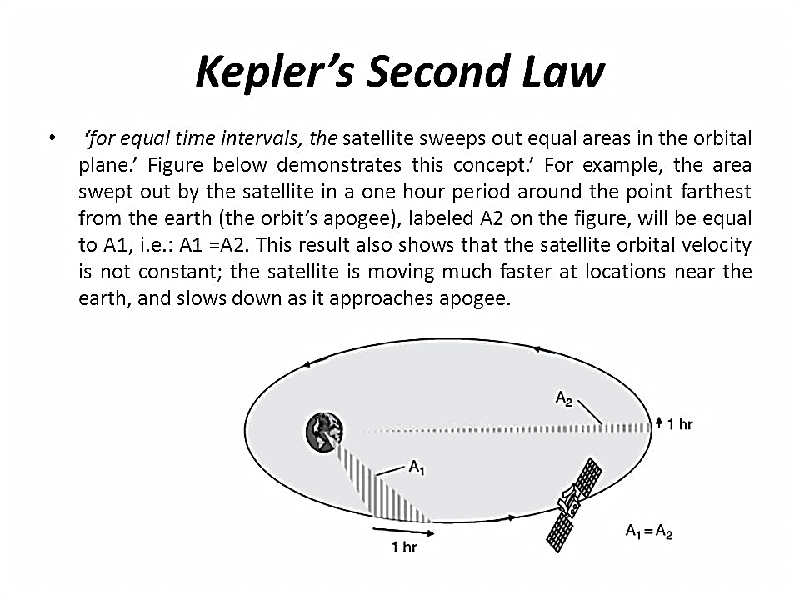

Slide 24
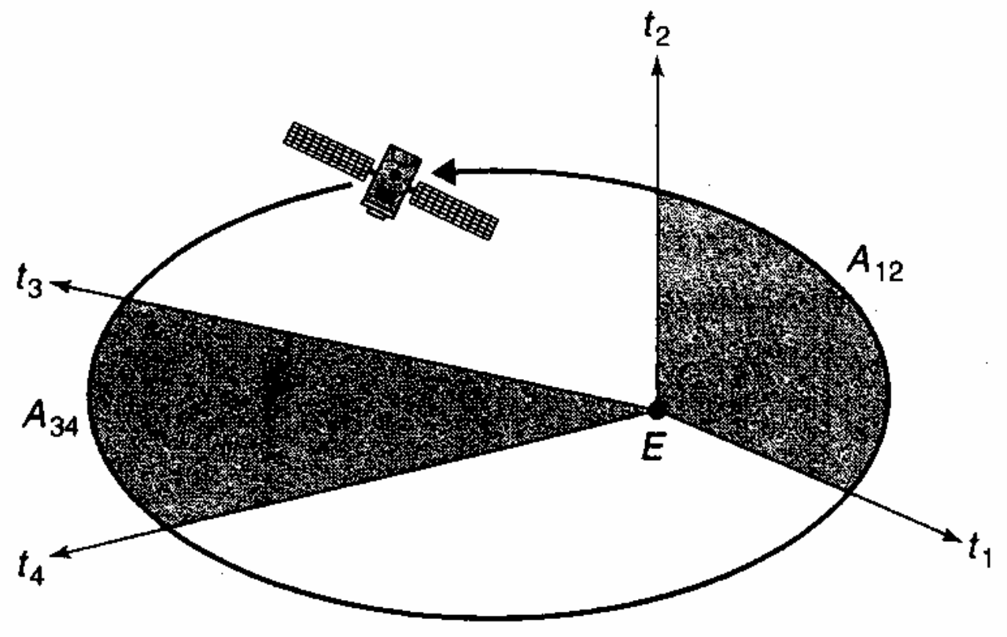
The orbit of the smaller body sweeps out equal areas in equal time (see Figure 2.5).
FIGURE 2.5 Illustration of Kepler's second law of planetary motion.
A satellite is in orbit about the planet earth, E.
The orbit is an ellipse with a relatively high eccentricity, that is, it is far from being circular.
The figure shows two shaded portions of the elliptical plane in which the orbit moves, one is close to the earth and encloses the perigee while the other is far from the earth and encloses the apogee.

Slide 25
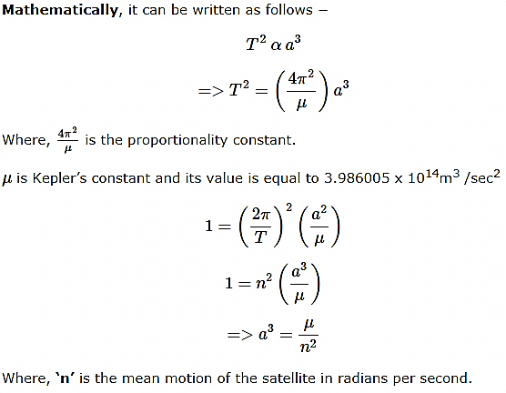
Kepler’s Third Law
Kepler’s third law states that, the square of the periodic time of an elliptical orbit is proportional to the cube of its semi major axis length.

Slide 26
The perigee is the point of closest approach to the earth while the apogee is the point in the orbit that is farthest from the earth.
While close to perigee, the satellite moves in the orbit between times t₁ and t₂ : and sweeps out an area denoted by A₁₂ .
While close to apogee, the satellite moves in the orbit between times t₃ and t₄, and sweeps out an area denoted by A₃₄.
If t₁ – t₂ = t₃ – t₄ then A₁₂ = ^{A}34.

Slide 27

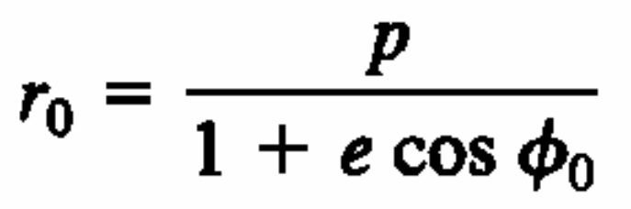
Describing the Orbit of a Satellite
The quantity θ₀ in Eq. (2.15 ) serves to orient the ellipse with respect to the orbital plane axes x₀ and y₀.
Now that we know that the orbit is an ellipse, we can always choose x₀ and y₀ so that θ₀ is zero.
We will assume that this has been done for the rest of this discussion.
This now gives the equation of the orbit as
(2.17)
The path of the satellite in the orbital plane is shown in Figure 2.6.
The lengths a and b of the semimajor and semiminor axes are given by [semilatus rectum p = (h ²)/µ ]
h is the magnitude of the orbital angular momentum of the satellite.
a = p / (1 — e ²)
b = a(1—e²)^{½}
(2.18)
(2.19)

Slide 28
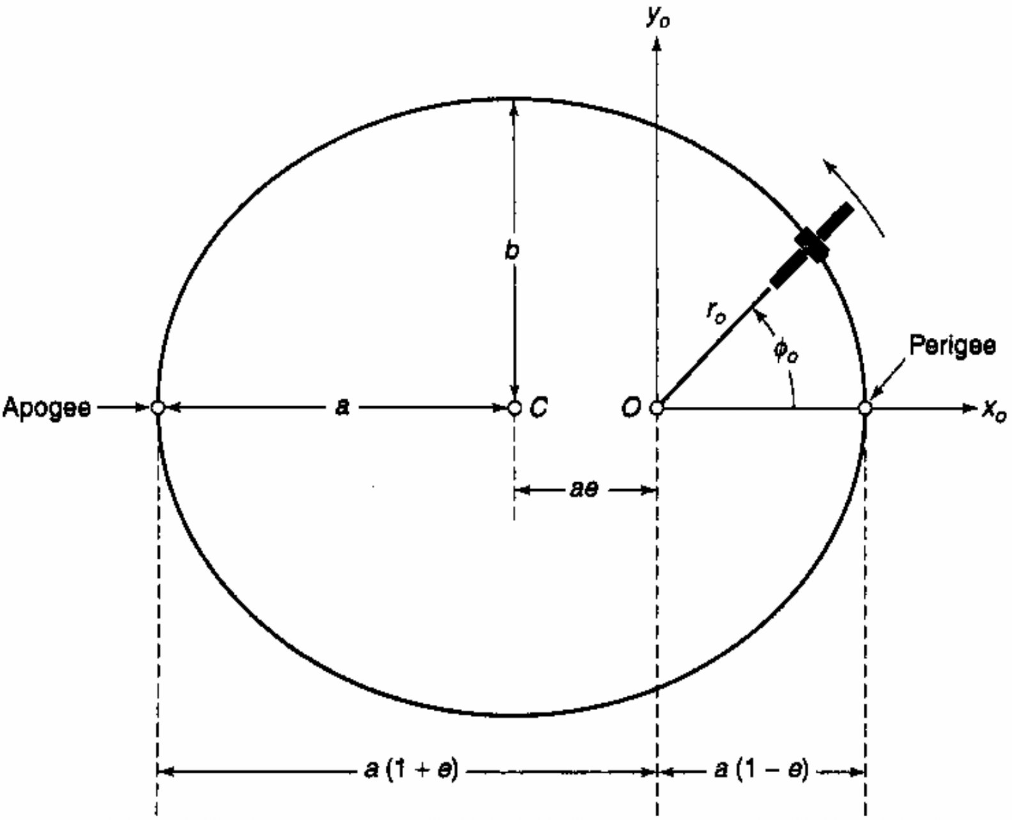
FIGURE 2.6 The orbit as it appears in the orbital plane.
The point 0 is the center of the earth and the point C is the center of the ellipse. The two centers do not coincide unless the eccentricity, e, of the ellipse is zero (i.e., the ellipse becomes a circle and a = b).
The dimensions a and b are the semimajor and semiminor axes of the orbital ellipse, respectively.

Slide 29
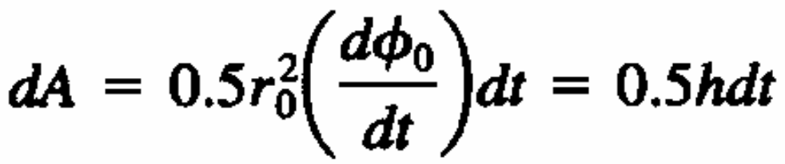
The point in the orbit where the satellite is closest to the earth is called the perigee and the point where the satellite is farthest from the earth is called the apogee.
The perigee and apogee are always exactly opposite each other.
To make θ₀ equal to zero, we have chosen the x₀ axis so that both the apogee and the perigee lie along it and the x₀ axis is therefore the major axis of the ellipse.
The differential area swept out by the vector r₀ from the origin to the satellite in time dt is given by
(2.20)

Slide 30
Remembering that h is the magnitude of the orbital angular momentum of the satellite,
The radius vector of the satellite can be seen to sweep out equal areas in equal times. This is Kepler’s second law of planetary motion.
By equating the area of the ellipse (πab) to the area swept out in one orbital revolution, we can derive an expression for the orbital period T as
This equation is the mathematical expression of Kepler’s third law of planetary motion:
The square of the period of revolution is proportional to the cube of the semimajor axis.
(Note that this is the square of Eq. (2.6) and that in Eq. (2.6) the orbit was assumed to be circular such that semimajor axis a = semiminor axis, b = circular orbit radius from the center of the earth r.)
T ² = (4π²a ³) / u (2.21)

Slide 31
Kepler’s third law extends result from Eq. (2.6), T = (2πr^{3/2}) / (μ½) which was derived for a circular orbit, to the more general case of an elliptical orbit. Equation (2.21) is extremely important in satellite communications systems. T ² = (4π²a ³) / u
This equation determines the period of the orbit of any satellite, and it is used in every GPS receiver in the calculation of the positions of GPS satellites.
Equation (2.21) is also used to find the orbital radius of a GEO satellite, for which the period T must be made exactly equal to the period of one revolution of the satellite to remain stationary over a point on the equator.
An important point to remember is that the period of revolution, T, is referenced to inertial space, namely, to the galactic background.

Slide 32
The orbital period is the time the orbiting body takes to return to the same reference point in space with respect to the galactic background.
Nearly always, the primary body will also be rotating and so the period of revolution of the satellite may be different from that perceived by an observer who is standing still on the surface of the primary body.
This is most obvious with a geostationary earth orbit (GEO) satellite (see Table 2.1).
The orbital period of a GEO satellite is exactly equal to the period of rotation of the earth, 23 h 56 min 4.1 s, but, to an observer on the ground, the satellite appears to have an infinite orbital period: it always stays in the same place in the sky.

Slide 33
To be perfectly geostationary, the orbit of a satellite needs to have three features:
It must be exactly circular (i.e., have an eccentricity of zero)
It must be at the correct altitude (i.e., have the correct Period)
(c) It must be in the plane of the equator
(i.e., have a zero inclination with respect to the equator).
If the inclination of the satellite is not zero and/or if the eccentricity is not zero, but the orbital period is correct, then the satellite will be in a geosynchronous orbit.
The position of a geosynchronous satellite will appear to oscillate about a mean look angle in the sky with respect to a stationary observer on the earth’s surface.

Slide 34
The orbital period of a GEO satellite, 23 h 56 min 4.1 s, is one sidereal day.
A sidereal day is the time between consecutive crossings of any particular longitude on the earth by any star, other than the sun¹.
The mean solar day of 24 h is the time between any consecutive crossings of any particular longitude by the sun, and is the time between successive sunrises (or sunsets) observed at one location on earth, averaged over an entire year.
Because the earth moves round the sun once per 365¼ days, the solar day is 1440/365.25 = 3.94 min longer than a sidereal day.

Slide 35

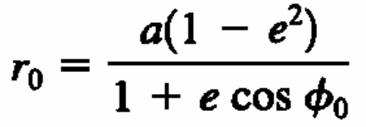
Locating the Satellite in the Orbit
Consider now the problem of locating the satellite in its orbit.
The equation of the orbit maybe rewritten by combining Eqs. (2.15) and (2.18) to obtain
a = p / (1 — e ²)
(2.22)
The angle φ₀ (see Figure 2.6) is measured from the x₀ axis and is called the true anomaly.
[Anomaly was a measure used by astronomers to mean a planet’s angular distance from its perihelion (closest approach to the sun), measured as if viewed from the sun. The term was adopted in celestial mechanics for all orbiting bodies.]
27

Slide 36
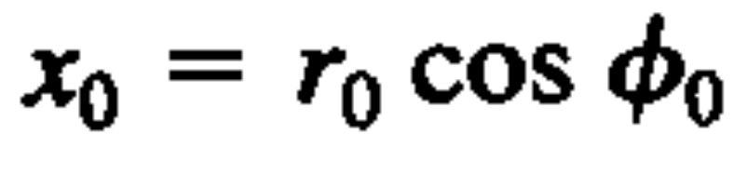
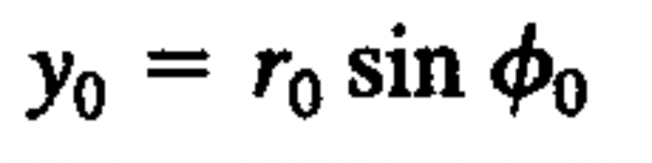
Since we defined the positive x₀ axis so that it passes through the perigee,
ø₀ measures the angle from the perigee to the instantaneous position of the satellite.
The rectangular coordinates of the satellite are given by
(2.23)
(2.24)

Slide 37
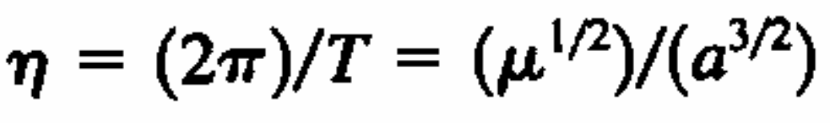
As noted earlier, the orbital period T is the time for the satellite to complete a revolution in inertial space, traveling a total of 2π radians. The average angular velocity η is thus
(2.25)
T = (2πr^{3/2}) / (μ½)

Slide 38
If the orbit is an ellipse, the instantaneous angular velocity will vary with the position of the satellite around the orbit.
If we enclose the elliptical orbit with a circumscribed circle of radius a (see Figure 2.7), then an object going around the circumscribed circle with a constant angular velocity η would complete one revolution in exactly the same period T as the satellite requires to complete one (elliptical) orbital revolution.

Slide 39
Consider the geometry of the circumscribed circle as shown in Figure 2.7.
Locate the point (indicated as A) where a vertical line drawn through the position of the satellite intersects the circumscribed circle.
A line from the center of the ellipse (C) to this point (A) makes an angle E with the x₀ axis; E is called the eccentric anomaly of the satellite.

Slide 40
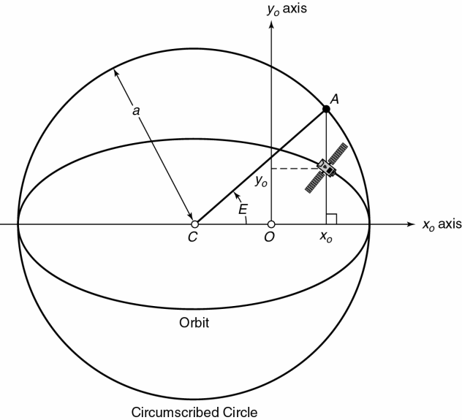
Figure 2.7
The circumscribed circle and the eccentric anomaly E. Point O is the center of the earth and point C is both the center of the orbital ellipse and the center of the circumscribed circle. The satellite location in the orbital plane coordinate system is specified by ( x₀, y₀). A vertical line through the satellite intersects the circumscribed circle at point A. The eccentric anomaly E is the angle from the x₀ axis to the line joining C and A.

Slide 41
r_{o} = a(1 – e cos E)
It is related to the radius r₀ by
(2.26)
Thus a – r₀ = ae cos E
(2.27)
We can also develop an expression that relates eccentric anomaly E to the average angular velocity η, which yields
η dt = (1 – e cosE) dE (2.28)

Slide 42
Let t_{p} be the time of perigee. This is simultaneously the time of closest approach to the earth; The time when the satellite is crossing the x₀ axis; and the time when E is zero. If we integrate both sides of Eq. (2.28), ηdt = (1 – e cosE) dE we obtain
η (t – t_{p}) = E – e sinE
The left side of Eq. (2.29) is called the mean anomaly, M. Thus
M = η (t -t_{p}) = E – e sinE
(2.29)
(2.30)

Slide 43
The mean anomaly M is the arc length (in radians) that the satellite would have traversed since the perigee passage if it were moving on the circumscribed circle at the mean angular velocity η.

Slide 44


If we know the time of perigee, t_{p}, the eccentricity, e, and the length of the semimajor axis, a, we now have the necessary equations to determine the coordinates (r₀, ø₀ ) and (x₀, y₀) of the satellite in the orbital plane.
The process is as follows
Calculate η using Eq. (2.25).
Calculate M using Eq. (2.30). M = η (t -t_{p}) = E – e sinE
Solve Eq. (2.30) for E.
Find r_{o} form E using Eq. (2.27). a – r₀ = ae cos E
Solve Eq. (2.22) for ø₀ .
Use Eqs. (2.23) and (2.24) to calculate x₀ and y₀ .
Now we must locate the orbital plane with respect to the earth.

Slide 45
Locating the satellite with Respect to the Earth
At the end of the last section, we summarized the process for locating the satellite at the point (x₀, y₀, z₀) in the rectangular coordinate system of the orbital plane.
The location was with respect to the center of the earth.
In most cases, we need to know where the satellite is from an observation point that is not at the center of the earth.
We will therefore develop the transformations that permit the satellite to be located from a point on the rotating surface of the earth.
We will begin with a geocentric equatorial coordinate system as shown in Figure 2.8.

Slide 46
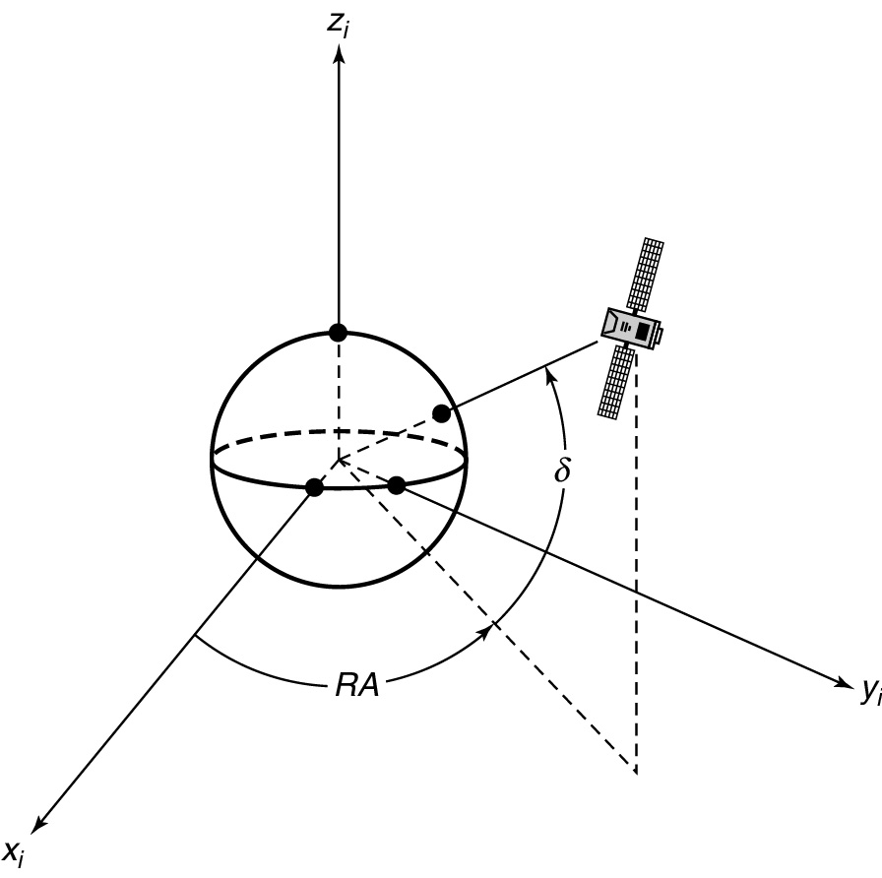
Figure 2.8
The geocentric equatorial system. This geocentric syst em diff ers from that shown in Figure 2. 1 only in that the x_{i} axis points to the first point of Aries. The first point of Aries is the direction of a line from the center of the earth through the center of the sun at the ver nal equinox (about March 21 in the Nort hern Hemisphere), the instant when the subsolar point crosses the equator fr om south to north. In the above system, an object maybe located by its right ascension RA and its declination δ.
78
Satellite Communications, 2/E by Timothy Pratt, Charles Bostian, & Jeremy Allnutt Copy right © 2003 John Wiley & Sons. Inc. All rights reserved.

Slide 47
The rotational axis of the earth is the Z_{i} axis, which is through geographic North Pole.
The x_{i} axis is from the center of the earth toward a fixed location in space called the first point of Aries (see Figure 2.8).
This coordinate system moves through space; it translates as the earth moves in its orbit around the sun, but it does not rotate as the earth rotates.
The x_{i} direction is always the same, whatever the earth’s position around the sun and is in the direction of the first point of Aries.
The (x_{i} , y_{i}) plane contains the earth’s equator and is called the equatorial plane.

Slide 48
Angular distance measured eastward in the equatorial plane from the x_{i} axis is called right ascension and given the symbol RA.
The two points at which the orbit penetrates the equatorial plane are called nodes;
the satellite moves upward through the equatorial plane at the ascending node and downward through the equatorial plane at the descending node,
given the conventional picture of the earth, with north at the top, which is in the direction of the positive z axis for the earth centered coordinate set.

Slide 49
Figure 2.8
The geocentric equatorial system. This geocentric syst em diff ers from that shown in Figure 2. 1 only in that the x_{i} axis points to the first point of Aries. The first point of Aries is the direction of a line from the center of the earth through the center of the sun at the ver nal equinox (about March 21 in the Nort hern Hemisphere), the instant when the subsolar point crosses the equator fr om south to north. In the above system, an object maybe located by its right ascension RA and its declination δ.
78
Satellite Communications, 2/E by Timothy Pratt, Charles Bostian, & Jeremy Allnutt Copy right © 2003 John Wiley & Sons. Inc. All rights reserved.

Slide 50
Remember that in space there is no up or down ; that is a concept we are familiar with because of gravity at the earth’s surface.
For a weightless body in space, such as an orbiting spacecraft, up and down have no meaning unless they are defined with respect to a reference point.
The right ascension of the ascending node is called Ω.
The angle that the orbital plane makes with the equatorial plane (the planes intersect at the line joining the nodes) is called the inclination , i.
Figure 2.9 illustrates these quantities.

Slide 51
The variables Ω and i together locate the orbital plane with respect to the equatorial plane.
To locate orbital coordinate system with respect to the equatorial coordinate system we need ω, the argument of perigee west.
This is the angle measured along the orbit from the ascending node to the perigee.

Slide 52
Standard time for space operations and most other scientific and engineering purposes is universal time (UT), also known as zulu time (Z).
This is essentially the mean solar time at the Greenwich Observatory near London, England.
Universal time is measured in hours, minutes, and seconds or in fractions of a day. It is 5 h late than Eastern Standard Time, so that 07:00 EST is 12:00:00 h UT.
The civil or calendar day begins at 00:00:00 hours UT, frequently written as 0 h.

Slide 53
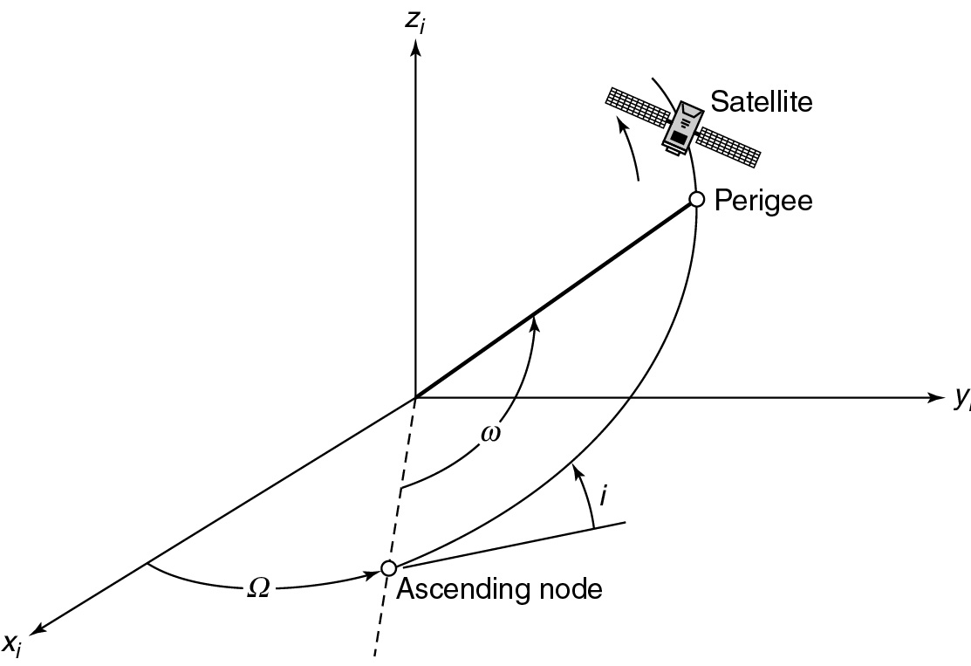
Figure 2.9
Locating the orbit in the geocentric equatorial system. The satellite penetrates the equatorial plane (while moving in the positive z direction) at the ascending node.
The right ascension of the ascending node is Ω and the inclination i is the angle between the equatorial plane and the orbital plane. Angle ῳ, measured in the orbital plane, locates the perigee with respect to the equatorial plane.
82
Satellite Communications, 2/E by Timothy Pratt, Charles Bostian, & Jeremy Allnutt Copy right © 2003 John Wiley & Sons. Inc. All rights reserved.

Slide 54
Orbital Elements
To specify the absolute (i.e., the inertial) coordinates of a satellite at time t, we need to know six quantities.
(This was evident earlier when we determined that a satellite’s equation of motion was a second order vector linear differential equation).
These quantities are called the orbital elements.
More than six quantities can be used to describe a unique orbital path and there is some arbitrariness in exactly which six quantities are used.
We have chosen to adopt a set that is commonly used in satellite communications:
eccentricity (e), semimajor axis (a), time of perigee (t_{p}),
right ascension of ascending node (Ω),
inclination (i), and argument of perigee (ω).
Frequently, the mean anomaly (M) at a given time is substituted for t_{p}.

Slide 55
2. Look Angle Determination
Navigation around the earth’s oceans became more precise when the surface of the globe was divided up into a gridlike structure of orthogonal lines: latitude and longitude.
Latitude is the angular distance, measured in degrees, north or south of the equator and longitude is the angular distance, measured in degrees, from a given reference longitudinal line.
At the time that this grid reference became popular, there were two major seafaring nations vying for dominance: England and France.
England drew its reference zero longitude through Greenwich, a town close to London, England, and France, not surprisingly, drew its reference longitude through Paris, France.

Slide 56
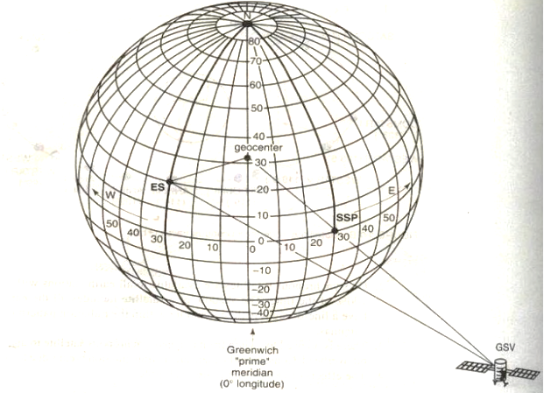

Slide 57
Since the British Admiralty chose to give away their maps and the French decided to charge a fee for theirs, it was not surprising that the use of Greenwich as the zero reference longitude became dominant within a few years.
The coordinates to which an earth station antenna must be pointed to communicate with a satellite are called the look angles.
These are most commonly expressed as azimuth (Az ) and elevation (El), although other pairs exist.
For example, right ascension(RA) and declination(δ) are standard for radio astronomy antennas.

Slide 58
Azimuth is measured eastward (clockwise) from geographic north to the projection of the satellite path on a (locally) horizontal plane at the earth station.
Elevation is the angle measured upward from the local horizontal plane at the earth station to the satellite path.
Figure 2.10 illustrates these look angles.
In all look angle determinations , the precise location of the satellite is critical.
A key location in many instances is the subsatellite point.

Slide 59
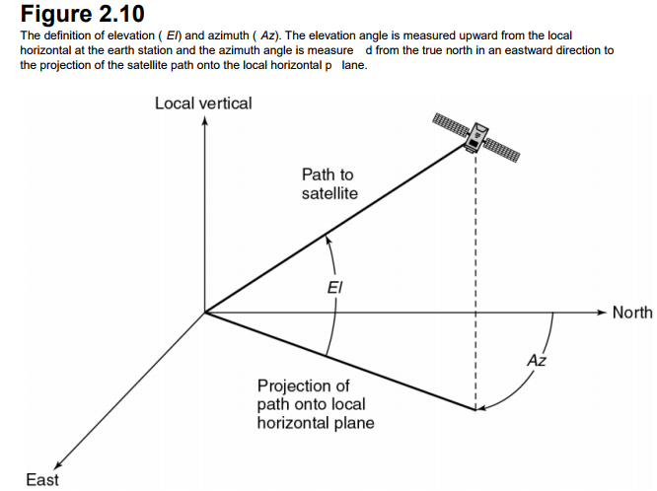

Slide 60
The subsatellite Point
The subsatellite point is the location on the surface of the earth that lies directly between the satellite and the center of the earth.
It is the nadir pointing direction from the satellite and, for a satellite in an equatorial orbit, It will always be located on the equator.
Since geostationary satellites are in equatorial orbits and are designed to stay “stationary” over the earth, it is usual to give their orbital location in terms of their subsatellite point.
As noted in the example given earlier, the Intelsat primary satellite in the Atlantic Ocean Region (AOR) is at 335.5 ˚ E longitude.

Slide 61
To an observer of a satellite standing at the subsatellite point, the satellite will appear to be directly overhead, in the zenith direction form the observing location.
The zenith and nadir paths are therefore in opposite directions along the same path (see Figure 2.11).
Designers of satellite antennas reference the pointing direction of the satellite’s antenna beams to the nadir direction.

Slide 62
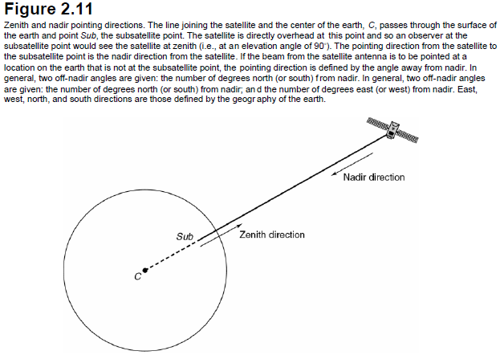

Slide 63
Elevation Angle Calculation
Figure 2.12 shows the geometry of the elevation angle calculation.
In Figure 2.12, rs is the vector from the center of the earth to the satellite;
re is the vector from the center of the earth to the earth station; and d is the vector from the earth station to the satellite.
These three vectors lie in the same plane and form a triangle.
The central angle γ measured between re and rs is the angle between the earth station and the satellite, and ψ is the angle (within the triangle) measured from re to d.

Slide 64
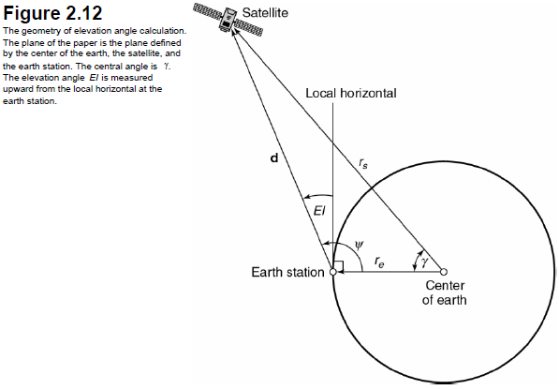

Slide 65
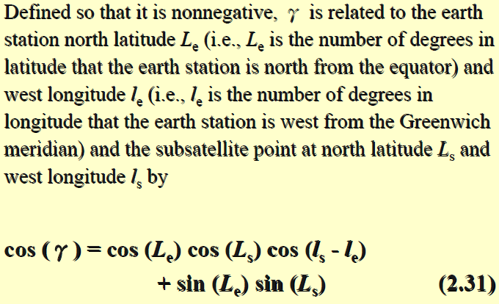

Slide 66
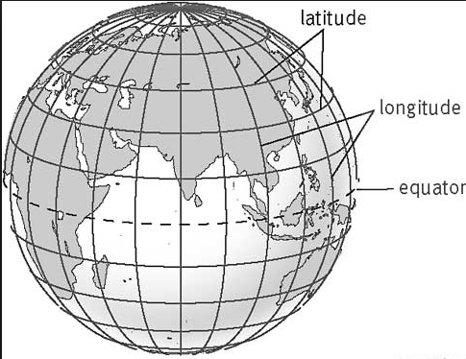

Slide 67
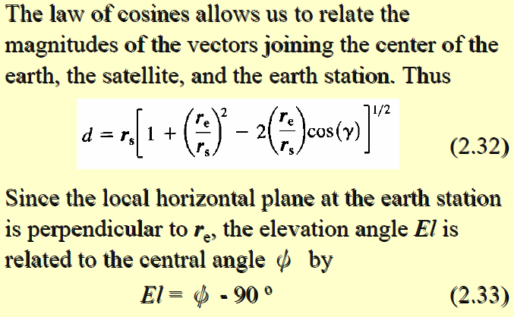

Slide 68
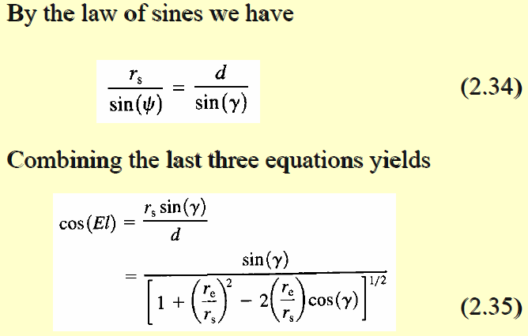

Slide 69
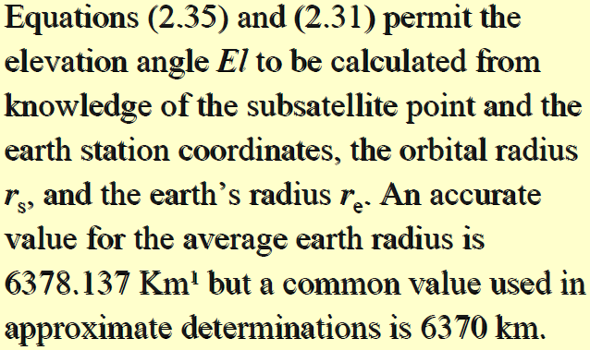

Slide 70
Azimuth Angle Calculation
Because the earth station, the center of the earth, the
satellite, and the subsatellite point all lie in the same
plane, the azimuth angle Az from the earth station to the satellite is the same as the azimuth from the earth
station to the subsatellite point.
This is more difficult to compute than the elevation angle because the exact geometry involved depends on whether the subsatellite point is east or west of the earth station, and in which of the hemispheres the earth station and the subsatellite point are located.
Page-34

Slide 71
Specialization to Geostationary Satellites
For most geostationary satellites, the subsatellite point is on the equator at longitude ls , and the latitude Ls is 0.
The geosynchronous radius rs is 42,164.17 km¹. Since Ls is zero, Eq. (2.31) simplifies to
cos (γ) = cos (Le) cos (ls - le)………. (2.36)

Slide 72
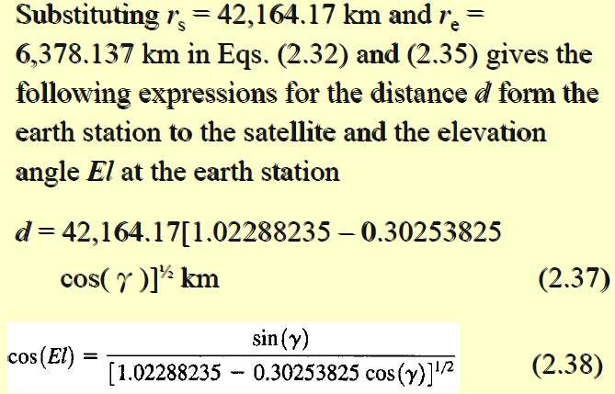

Slide 73
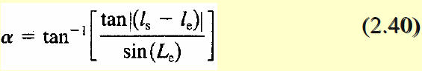
For a geostationary satellite with an orbital radius of 42,164.17 km and a mean earth radius of 6378.137 km, the ratio rs / re = 6.6107345 giving
El = tan-¹ [(6.6107345 – cos γ)/sin γ] -γ …….(2.39)
To find the azimuth angle, an intermediate angle α must first be found.
The intermediate angle α permits the correct 90˚ quadrant to be found for the azimuth since the azimuthal angle can lie anywhere between 0˚ (true north) and clockwise through 360˚ (back to true north again).
The intermediate angle is found from

Slide 74
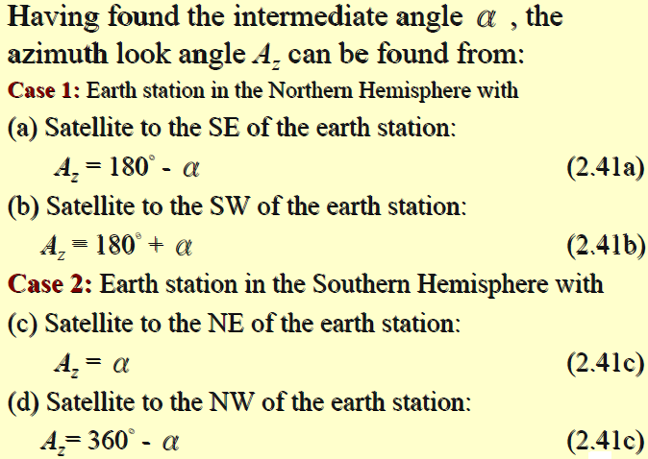

Slide 75
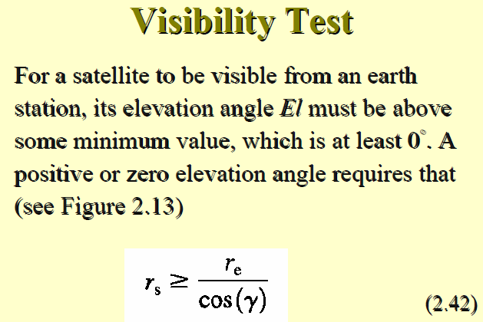

Slide 76
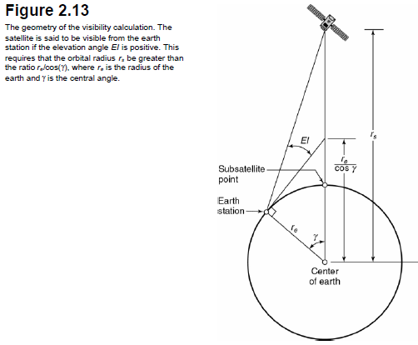

Slide 77
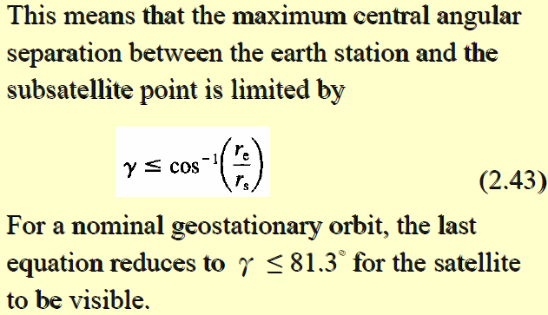

Slide 78
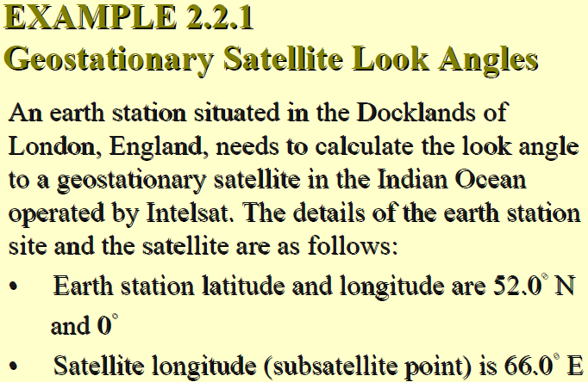

Slide 79
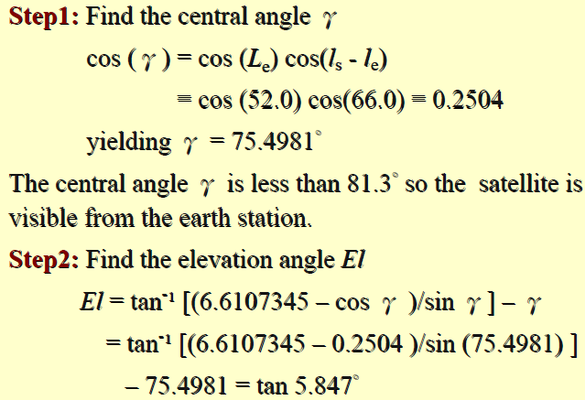

Slide 80


Slide 81
Note that, in example above, the elevation angle is relatively low (5.85˚).
Refractive effects in the atmosphere will cause the mean ray path to the satellite to bend in the elevation place (making the satellite appear to be higher in the sky than it actually is) and to cause the amplitude of the signal to fluctuate with time.
A number of geosynchronous orbit satellites have inclinations that are much larger than the nominal 0.05˚ inclination maximum for current geosynchronous satellites.
(In general, a geosynchronous satellite with an inclination of < 0.1
may be considered to be geostationary.)
In extreme cases, the inclination can be several degrees, particularly if the orbit maneuvering fuel of the satellite is almost exhausted and the satellite’s position in the nominal location is only controlled in longitude and not in inclination.

Slide 82
This happens with most geostationary communications satellites toward the end of their operational lifetime since the reliability of the payload, or a large part of the payload, generally exceeds that of the lifetime of the maneuvering fuel.
Those satellites that can no longer be maintained in a fully geostationary orbit, but are still used for communications services, are referred to as inclined orbit satellites.

Slide 83
3. ORBITAL PERTURBATIONS
The orbital equations developed in Section 2.1 modeled the earth and the satellite as point masses influenced only by gravitational attraction.
Under these ideal conditions, a “Keplerian” orbit results, which is an ellipse whose properties are constant with time.
In practice, the satellite and the earth respond to many other influences including asymmetry of the earth’s gravitational field, the gravitational fields of the sun and the moon, and solar radiation pressure.

Slide 84
Longitudinal Changes: Effects of the Earth’s Oblateness
The earth is neither a perfect sphere nor a perfect ellipse; it can be better described as a triaxial ellipsoid.
The earth is flattened at the poles; the equatorial diameter is about 20 km more than the average polar diameter.
The equatorial radius is not constant, although the noncircularity is small: the radius does not vary by more than about 100 m around the equator1

Slide 85
Inclination Changes: Effects of the Sun and Moon
The plane of the earth’s orbit around the sun–the ecliptic–is at inclination of 7.3˚ to the equatorial plane of the sun(Figure 2.14).
The earth is titled about 23˚ away from the normal to the ecliptic.
The moon circles the earth with an inclination of around 5˚ to the equatorial plane of the earth.
Due to the fact that the various planes–the sun’s equator, the ecliptic, the earth’s equator (a plane normal to the earth’s rotational axis), and the moon’s orbital plane around the earth–are all different, a satellite in orbit around the earth will be subjected to a variety of out–of–plane forces.

Slide 86


Slide 87


Slide 88


Slide 89


Slide 90
4. ORBIT DETERMINATION
Orbit determination requires that sufficient measurements be made to determine uniquely the six orbital elements needed to calculate the future orbit of the satellite, and hence calculate the required changes that need to be made to the orbit to keep it within the nominal orbital location.
Three angular position measurements are needed because there are six unknowns and each measurement will provide two equations.
Conceptually, these can be thought of as one equation giving the azimuth and the other the elevation as a function of the six ( as yet unknown) orbital elements.

Slide 91
4. ORBIT DETERMINATION…………cont
The control earth stations used to measure the angular position of the satellites also carry out range measurements using unique time stamps in the telemetry stream or communications carrier.
These earth stations are generally referred to as the TTC&M (Telemetry tracking command and monitoring) stations of the satellite network.
Major satellite networks maintain their own TTC&M stations around the world.
Smaller satellite systems generally contract for such TTC&M functions from the spacecraft manufacturer or from the larger satellite system operators, as it is generally uneconomic to build advanced TTC&M stations with fewer than three satellites to control.

Slide 92
5. LAUNCHES AND LAUNCH VEHICLES
A satellite cannot be placed into a stable orbit unless two parameters that are uniquely coupled together–the velocity vector and the orbital height–are simultaneously correct.
There is little point in obtaining the correct height and not having the appropriate velocity component in the correct direction to achieve the desired orbit.

Slide 93
A geostationary satellite, for example, must be in an orbit at a height of 35,786.03 km above the surface of the earth (42,164.17-km radius form the center of the earth) with an inclination of zero degrees, an ellipticity of zero, and a velocity of 3074.7 m/s tangential to the earth in the plane of the orbit, which is the earth’s equatorial plane.
The further out from the earth the orbit is, the greater the energy required from the launch vehicle to reach that orbit.
In any earth satellite launch, the largest fraction of the energy expended by the rocket is used to accelerate the vehicle from rest until it is about 20 miles (32km) above the earth.

Slide 94
To make the most efficient use of the fuel, it is common to shed excess mass from the launcher as it moves upward on launch: this is called staging.
Figure 2.15 gives a schematic of a Proton launch from the Russian Baikonur complex at Kazakhstan, near Tyuratam.

Slide 95


Slide 96
Some of the launch vehicles deliver the spacecraft directly to geostationary orbit (called a direct-insertion launch) while others inject the spacecraft into a Geostationary Transfer Orbit (GTO).
Spacecraft launched into GTO must carry additional rocket motors and/or propellant to enable the vehicle to reach the geostationary orbit.
There are three basic ways to achieve geostationary orbit.

Slide 97
Placing Satellites into Geostationary Orbit
Geostationary Transfer Orbit and AKM
The initial approach to launching geostationary satellites was to place the spacecraft, with the final rocket stage still attached, into low earth orbit.
After a couple of orbits, during which the orbital elements are measured, the final stage is reignited and the spacecraft is launched into a geostationary transfer orbit.
AKM-Apogee kick motor

Slide 98
The GTO has a perigee that is the original LEO orbit altitude and an apogee that is the GEO altitude.
Figure 2.19 illustrates the process.
The position of apogee point is close to the orbital longitude that would be the in-orbit test location of the satellite prior to it being moved to its operational position.

Slide 99


Slide 100
Again, after a few orbits in the GTO while the orbital elements are measured, a rocket motor (usually contained within the satellite itself) is ignited at apogee and the GTO is raised until it is a circular, geostationary orbit.
Since the rocket motor fires at apogee, it is commonly referred to as the apogee kick motor (AKM).
The AKM is used both to circularize the orbit at GEO and to remove any inclination error so that the final orbit of the satellite is very close to geostationary.

Slide 101
Geostationary Transfer Orbit with Slow Orbit Raising
In this procedure, rather than employ an apogee kick motor that imparts a vigorous acceleration over a few minutes, the spacecraft thrusters are used to raise the orbit from GTO to GEO over a number of burns.
Since the spacecraft cannot be spin-stabilized during the GTO (so as not to infringe the Hughes patent), many of the satellite elements are deployed while in GTO, including the solar panels.
The satellite has two power levels of thrusters: one for more powerful orbit raising maneuvers and one for onorbit (low thrust) maneuvers.

Slide 102
Since the thrusters take many hours of operation to achieve the geostationary orbit, the perigee of the orbit is gradually raised over successive thruster firings.
The thruster firings occur symmetrically about the apogee although they could occur at the perigee as well.
The burns are typically 60 to 80 min long on successive orbits and up to six orbits can be used.
Figure 2.20 illustrates the process.

Slide 103


Slide 104
Direct Insertion to GEO
This is similar to the GTO technique but, In this case, the launch service provider contracts to place the satellite into GEO.
The final stages of the rocket are used to place the satellite directly into GEO rather than the satellite using its own propulsion system to go from GTO to GEO.

Slide 105
EXAMPLE 2.6.1 Doppler Shift for a LEO Satellite
A low earth orbit satellite is in a circular polar orbit with an altitude, h, of 1000km. A transmitter on the satellite has a frequency of 2.65 GHz. Find
(i) The velocity of the satellite in orbit
(ii) The component of velocity toward an observer at an earth station as the satellite appears over the horizon, for an observer who is in the plane of the satellite orbit.
(iii)Hence, find the Doppler shift of the received signal at the earth station. Use a mean earth radius value, re, of 6378 km. The satellite also carries a Ka-band transmitter at 20.0 GHz.
(iv)Find the Doppler shift for this signal when it is received by the same observer.

Slide 106


Slide 107


Slide 108


Slide 109


Slide 110


Slide 111
6. ORBITAL EFFECTS IN COMMUNICATIONS SYSTEMS PERFORMANCE
Doppler Shift :
To a stationary observer, the frequency of a moving radio transmitter varies with the transmitter’s velocity relative to the observer.
If the true transmitter frequency (i.e., the frequency that the transmitter would send when at rest) is fT , the received frequency fR is higher than fT when the transmitter is moving toward the receiver and lower than fT when the transmitter is moving away from the receiver.
Mathematically, the relationship between the transmitted and received frequencies is (fR – fT ) / fT = Δf / fT = VT / vp
Or Δf = (VT fT ) / c = VT / λ
Where VT is the component of the transmitter velocity directed toward the receiver.
Vp = c is the phase velocity of the light ( 3 x 108 m/s in free space)
λ is the wavelength of the transmitted signal.

Slide 112
If the transmitter is moving away from the receiver, then VT is negative. This change in frequency is called the Doppler shift, the Doppler effect, or more commonly just “Doppler” after the German physicist who first studied the phenomenon in sound waves.
For LED satellites, Doppler shift can be quite pronounced, requiring the use of frequency-tracking receivers.
For geostationary satellites, the effect is negligible.
Range Variations
Even with the best station-keeping systems available for geostationary satellites, the position of a satellite with respect to the earth exhibits a cycle daily variation.
The variation in position will lead to a variation in range between the satellite and user terminals.

Slide 113
If TDMA is being used, careful attention must be paid to the timing of frames within the TDMA bursts, so that the individual user frames arrive at the satellite in the correct sequence and at the correct time.
Range variations on LEO satellites can be significant, as can path loss variations.
While guard times b/w bursts can be increased to help in any range and/or timing inaccuracies, this reduces the capacity of transponder.
The on-board capabilities of some satellites permit both timing control of the burst sequence and power level control of individual user streams.

Slide 114
Solar Eclipse
A satellite is said to be in eclipse when the earth prevents sunlight from reaching it, that is, when the satellite is in the shadow of the earth.
For geostationary satellites, eclipses occur during two periods that begin 23 days before the equinoxes (about March 21 and about September 23) and end 23 days after the equinox periods.
Eclipses occur close to the equinoxes, as these are the times when the sun, the earth, and the satellite are all nearly in the same plane.
During full eclipse, a satellite receivers no power from its solar array and it must operate entirely from its batteries.
Batteries are designed to operate with a maximum depth of discharge: the better the battery, the lower the percentage depth of discharge can be.

Slide 115


Slide 116



Slide 117
Solar Eclipse.. cont
If the battery is discharged below its maximum depth of discharge, the battery may not recover to full operational capacity once recharged.
The depth of discharge therefore sets the power drain limit during eclipse operations.
Nickel-Hydrogen batteries, long the mainstay of communications satellites, can operate at about a 70% depth of discharge and recover fully once recharged.
Ground controllers perform battery-conditioning routines prior to eclipse operations to ensure the best battery performance during the eclipse.
The routines consist of deliberately discharging batteries until they are close to their maximum depth of discharge, and then fully recharging the batteries just before eclipse season begins.

Slide 118
Solar Eclipse.. cont
The eclipse season is a design challenge for spacecraft builders.
Not only is the main power source withdrawn(the sun) but also the rapidly with which the satellite enters and exits the shadow can cause extreme changes in both power and heating effects over relatively short periods.
Just like a common light bulb is more likely to fail when the current is switched on as opposed to when it is under steady state conditions, satellites can suffer many of their component failures under sudden stress situations.
Eclipse periods are therefore monitored carefully by ground controllers, as this is when most of the equipment failures are likely to occur.

Slide 119
Sun Transit Outage
During the equinox periods, not only does the satellite pass through the earth’s shadow on the “dark” side of the earth, but the orbit of the satellite will also pass directly in front of the sun on the sunlit side of the earth.(Fig.)
The sun is a “hot” microwave source with an equivalent temperature of about 6000 to 10000 K, depending on the time within the 11-year sunspot cycle, at the frequencies used by communications satellites (4 to 50 GHz).
The earth station antenna will therefore receive not only the signal from the satellite but also the noise temperature transmitted by the sun.
The added noise temperature will cause the fade margin of the receiver to be exceeded and an outage will occur.

Slide 120

Fig 2.23: Schematic of sun outage conditions. During the equinox periods, not only does the earth’s shadow cause eclipse periods to cover for geostationary satellites, during the sunlit portion of the orbit, there will be periods when the sun appears to be directly behind the satellite. At the frequencies used by communications satellites (4 to 50 GHz), the sun appears as a hot noise source. The effective temperature of the sun at these frequencies is on the order of 10,000 K. The precise temperature observed by the earth station antenna will depend on whether the beamwidth partially, or completely, encloses the sun.

Slide 121
Sun Transit Outage….cont
These outages may be precisely predicted.
For satellite system operators with more than one satellite at their disposal, traffic can be off-loaded to satellites that are just out of, or are yet to enter, a sun outage.
The outage in this situation can therefore be limited as far as an individual user is concerned.
However, the outages can be detrimental to operators committed to operations during daylight hours.

Slide 122
Orbital parameters
Apogee: A point for a satellite farthest from the Earth. It is denoted as ha.
Perigee: A point for a satellite closest from the Earth. It is denoted as hp.
Line of Apsides: Line joining perigee and apogee through centre of the Earth. It is the major axis of the orbit. One-half of this line‟s length is the semi-major axis equivalents to satellite‟s mean distance from the Earth.
Ascending Node: The point where the orbit crosses the equatorial plane going from north to south.
Descending Node: The point where the orbit crosses the equatorial plane going from south to north.

Slide 123
Inclination: the angle between the orbital plane and the Earth‟s equatorial plane. Its measured at the ascending node from the equator to the orbit, going from East to North. Also, this angle is commonly denoted as i.
Line of Nodes: the line joining the ascending and descending nodes through the centre of Earth.
Prograde Orbit: an orbit in which satellite moves in the same direction as the Earth‟s rotation. Its inclination is always between 00 to 900. Many satellites follow this path as Earth‟s velocity makes it easier to lunch these satellites.
Retrograde Orbit: an orbit in which satellite moves in the same direction counter to the Earth‟s rotation.
Argument of Perigee: An angle from the point of perigee measure in the orbital plane at the Earth‟s centre, in the direction of the satellite motion.

Slide 124

Mean anamoly: It gives the average value to the angular position of the satellite with reference to the perigee.
True anamoly: It is the angle from point of perigee to the satellite‟s position,

Slide 125



Slide 126
2.LOOK ANGLE DETERMINATION
The look angles for the ground station antenna are Azimuth and Elevation angles. They are required at the antenna so that it points directly at the satellite. Look angles are calculated by considering the elliptical orbit. These angles change in order to track the satellite.
For geostationary orbit, these angels values does not change as the satellites are stationary with respect to earth. Thus large earth stations are used for commercial communications, these antennas beamwidth is very narrow and the tracking mechanism is required to compensate for the movement of the satellite about the nominal geostationary position.
For home antennas, antenna beamwidth is quite broad and hence no tracking is essential. This leads to a fixed position for these antennas.

Slide 127
Look Angle Determination
The look angles for the ground station antenna are Azimuth and Elevation angles.
They are required at the antenna so that it points directly at the satellite.
Look angles are calculated by considering the elliptical orbit.
These angles change in order to track the satellite.
For GEO satellite, look angles of Earth Station only need to be adjusted once as satellite will remain in given position permanently, except for minor variations

Slide 128

Elevation Angle(EA)
The vertical angle formed between the direction of travel of EM wave radiated from an earth station antenna pointing directly toward a satellite and the horizontal plane.

Slide 129

The formula for elevation angle is
Smaller the EA,the greater the distance a propagated wave must pass through Earth’s atmosphere.
Longer the distance travelled, greater is its deterioration due to absorption and contamination by noise.
Generally,5˚ is considered as the minimum acceptable EA
Azimuth Angle
It is defined as the horizontal pointing angle of the Earth Station. It is measured eastward(clockwise)
Azimuth is the horizontal angular distance from a reference direction, either southern or northern most point of the horizon

Slide 130


The formula for Azimuth angle is
It is used to track the satellite horizontally.

Slide 131

Sub satellite Point
Point at which a line between the satellite and the centre of the Earth intersects the Earth’s surface
Location of the point expressed in terms of latitude and longitude
If one is in the US it is common to use
Latitude – degrees north from equator
Longitude –degrees west of the Greenwich meridian
Location of the sub satellite point may be calculated from coordinates of the rotating system as:

Slide 133


Slide 134
3.ORBITAL PERTURBATIONS
Theoretically, an orbit described by Kepler is ideal as Earth is considered to be a perfect sphere and the force acting around the Earth is the centrifugal force. This force is supposed to balance the gravitational pull of the earth.
In reality, other forces also play an important role and affect the motion of the satellite. These forces are the gravitational forces of Sun and Moon along with the atmospheric drag.
Effect of Sun and Moon is more pronounced on geostationary earth satellites where as the atmospheric drag effect is more pronounced for low earth orbit satellites.

Slide 135
2.4.1) Effects of non-Spherical Earth As the shape of Earth is not a perfect sphere, it causes some variations in the path followed by the satellites around the primary. As the Earth is bulging from the equatorial belt, and keeping in mind that an orbit is not a physical entity, and it is the forces resulting from an oblate Earth which act on the satellite produce a change in the orbital parameters.
This causes the satellite to drift as a result of regression of the nodes and the latitude of the point of perigee (point closest to the Earth). This leads to rotation of the line of apsides. As the orbit itself is moving with respect to the Earth, the resultant changes are seen in the values of argument of perigee and right ascension of ascending node.
Due to the non-spherical shape of Earth, one more effect called as the “Satellite Graveyard” is seen. The non-spherical shape leads to the small value of eccentricity (10-5 ) at the equatorial plane. This causes a gravity gradient on GEO satellite and makes them drift to one of the two stable points which coincide with minor axis of the equatorial ellipse.

Slide 136
Working satellites are made to drift back to their position but out-of-service satellites are eventually drifted to these points, and making that point a Satellite Graveyard.
(Note: A graveyard orbit, also called a supersynchronous orbit, junk orbit or disposal orbit, is an orbit significantly above GEO where satellites are intentionally placed at the end of theiroperational life. It is a measure performed in order to lower the probability of collisions with operational spacecraft and of the generation of additional space debris. The points where the graveyard is made are separated by 1800 on the equator and are set approximately on 750 E longitude and 1050 W longitude.)

Slide 137
2.4.2) Atmospheric Drag For Low Earth orbiting satellites, the effect of atmospheric drag is more pronounces. The impact of this drag is maximumat the point of perigee. Drag (pull towards the Earth) has an effect on velocity of Satellite (velocity reduces).
This causes the satellite to not reach the apogee height successive revolutions. This leads to a change in value of semi-major axis and eccentricity. Satellites in service are maneuvered by the earth station back to their original orbital position.

Slide 138
Prob: The apogee and perigee of an elliptical satellite orbits are 3000 Km and 200 Km. Determine the eccentricity, semi-major axis and semi-minor axis of the orbit.
The Apogee, ra = a (1+e) = 3000 km ….(1) , The Perigee, rp = a (1-e) = 200 km….(2)
Eqn’s (1) / (2) , [ 3000 / 200 ] = { a(1+e) / a (1-e) }
15 = ( 1+e / 1-e) , 15 -15e = 1+e , 14 = 16e, e = 14/16 = 7/8 = 0.875.
Use equation’s (1) or (2) , Find a = {3000/ 1+e} = 1600 km.
b= a [(1- e2)]½ = 1600 [ (1- (0.875)2 ] ½ = 774.592 km

Slide 139

Kepler’s Laws of Planetary Motions
1. Planets move in elliptical orbits with the sun at one of the foci
SUN
Foci – 2 points that are equidistant from center on major axis

Slide 140


Slide 141


Slide 142
Orbital parameters
Apogee: A point for a satellite farthest from the Earth. It is denoted as ha.
Perigee: A point for a satellite closest from the Earth. It is denoted as hp.
Line of Apsides: Line joining perigee and apogee through centre of the Earth. It is the major axis of the orbit. One-half of this line‟s length is the semi-major axis equivalents to satellite‟s mean distance from the Earth.
Ascending Node: The point where the orbit crosses the equatorial plane going from north to south.
Descending Node: The point where the orbit crosses the equatorial plane going from south to north.

Slide 143
Inclination: the angle between the orbital plane and the Earth‟s equatorial plane. Its measured at the ascending node from the equator to the orbit, going from East to North. Also, this angle is commonly denoted as i.
Line of Nodes: the line joining the ascending and descending nodes through the centre of Earth.
Prograde Orbit: an orbit in which satellite moves in the same direction as the Earth‟s rotation. Its inclination is always between 00 to 900. Many satellites follow this path as Earth‟s velocity makes it easier to lunch these satellites.
Retrograde Orbit: an orbit in which satellite moves in the same direction counter to the Earth‟s rotation.
Argument of Perigee: An angle from the point of perigee measure in the orbital plane at the Earth‟s centre, in the direction of the satellite motion.

Slide 144
Mean anamoly: It gives the average value to the angular position of the satellite with reference to the perigee.
True anamoly: It is the angle from point of perigee to the satellite‟s position,

Slide 146
Look Angle Determination
The look angles for the ground station antenna are Azimuth and Elevation angles.
They are required at the antenna so that it points directly at the satellite.
Look angles are calculated by considering the elliptical orbit.
These angles change in order to track the satellite.
For GEO satellite, look angles of Earth Station only need to be adjusted once as satellite will remain in given position permanently, except for minor variations

Slide 147
Elevation Angle(EA)
The vertical angle formed between the direction of travel of EM wave radiated from an earth station antenna pointing directly toward a satellite and the horizontal plane.

Slide 148
The formula for elevation angle is
Smaller the EA,the greater the distance a propagated wave must pass through Earth’s atmosphere.
Longer the distance travelled, greater is its deterioration due to absorption and contamination by noise.
Generally,5˚ is considered as the minimum acceptable EA
Azimuth Angle
It is defined as the horizontal pointing angle of the Earth Station. It is measured eastward(clockwise)
Azimuth is the horizontal angular distance from a reference direction, either southern or northern most point of the horizon

Slide 149
The formula for Azimuth angle is
It is used to track the satellite horizontally.

Slide 150
Sub satellite Point
Point at which a line between the satellite and the centre of the Earth intersects the Earth’s surface
Location of the point expressed in terms of latitude and longitude
If one is in the US it is common to use
Latitude – degrees north from equator
Longitude – degrees west of the Greenwich meridian
Location of the sub satellite point may be calculated from coordinates of the rotating system as:

Slide 154

Why 6 Orbit Elements?
1-D: Example: mass + spring like the dynamic model of last week position (1 number) plus velocity (1 number) necessary
2-D: Example: air hockey puck or single ball on pool table X & Y position, plus Velocity components along X & Y axes
3-D: Example: baseball in flight Altitude and position over field + 3-D velocity vector
Alternative Orbit determination systems
GPS: Latitude, Longitude, Altitude and 3-D velocity vector
Radar: Distance, distance rate, azimuth, elevation, Az rate, El rate
Ground sitings: Az El only (but done at many times / locations)
Breaking it down: Range R and Velocity V
R X V = h angular momentum vector = constant dot prod. with pole to get i
e² = 1 + 2E(h/µ)² where E = V ² /2 - µ/r
For sinγ = R . V/RV (γ is flight path angle to local horizon): tanθ = (RV ²/µ)sinγcosγ / [ (RV ² /µ)cos ² γ - 1 ]

